Slide 1










WEAR A
RAINBOW
November 2024

Slide 2

Our school is taking part in Wear a Rainbow Day to raise funds for Bridge the Gap Child Mental Health in Derby.

Slide 3


Exploring what Bridge the Gap do...

Slide 4
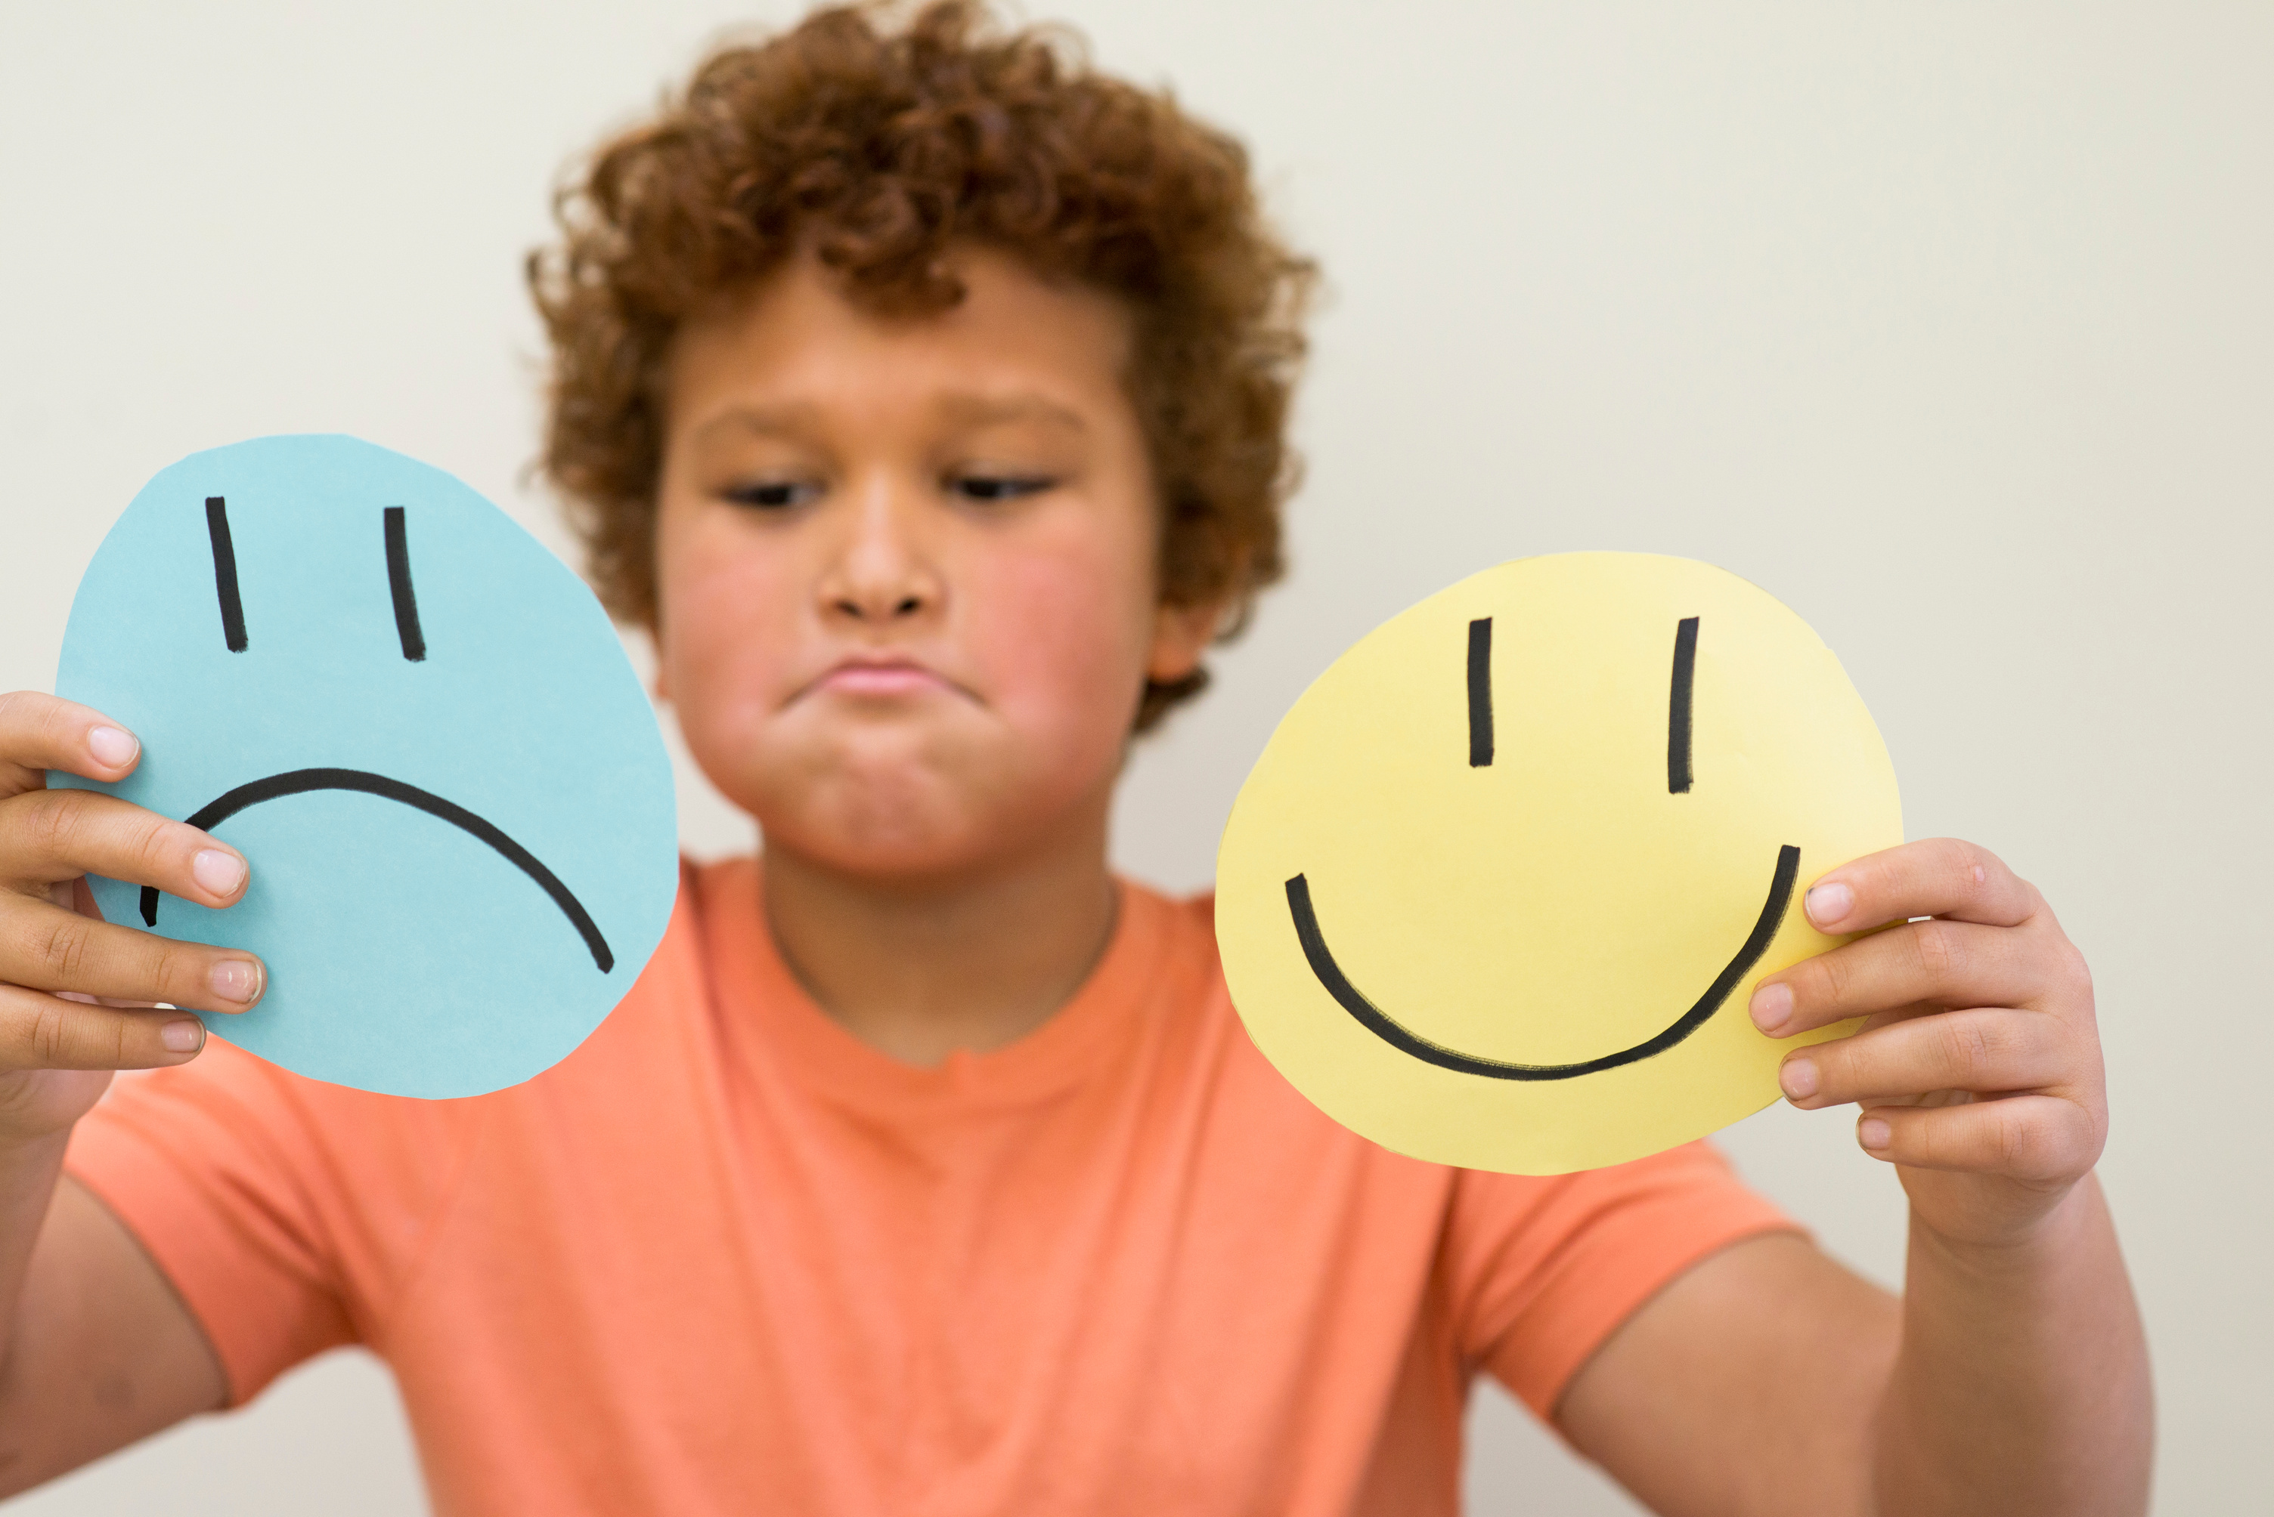
They help people to learn more about emotions and feelings.

Slide 5

They help people to feel good about themselves!

Slide 6

They support people who are feeling sad or who have had a big change in their life.

Slide 7

They learn about emotions through play, creativity and having fun!

Slide 8
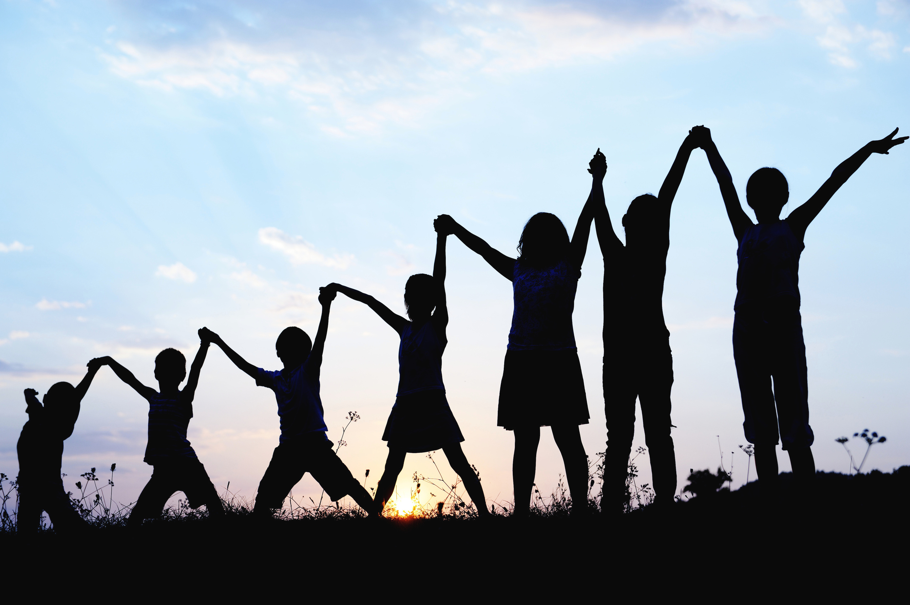
They enjoy themselves!

Slide 9

So, what are emotions?

Slide 10

Emotions are a name we give to the way we feel about different situations, our thoughts and the physical feelings in our body.

Slide 11
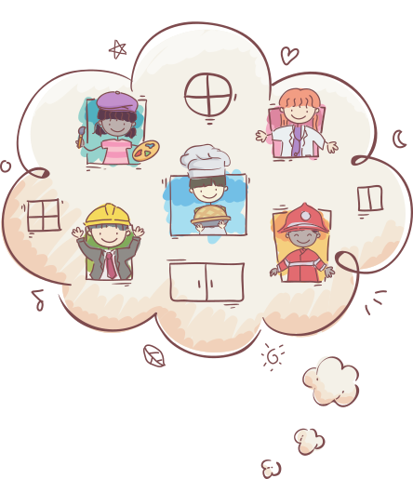
Our emotions help us to make decisions and stay safe, happy and healthy.

Slide 12

Emotions can feel BIG, loud
and uncomfortable.
Can you think of any emotions that are big and loud?

Slide 13

Or they can feel BIG, loud and easy.

Slide 14
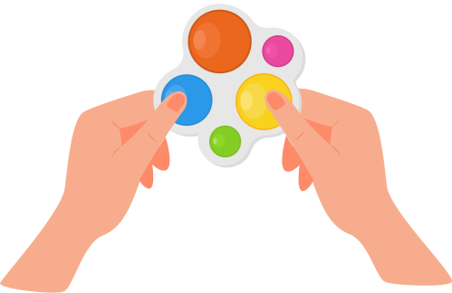
There are different things we can do to cope with difficult feelings until they pass.

Slide 15

A lot of emotions are quieter and more difficult to spot. Bridge the Gap help young people learn more about the quieter emotions underneath the louder ones.
Can you think of any emotions that are quiet and small?

Slide 16

All feelings are normal and they always pass. Even the more difficult emotions serve a purpose - we aren’t meant to be happy all of the time!

Slide 17
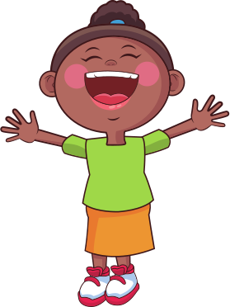
Learning about emotions can be fun! Exploring them helps us to understand how they feel in our bodies and what they are telling us.

Slide 18
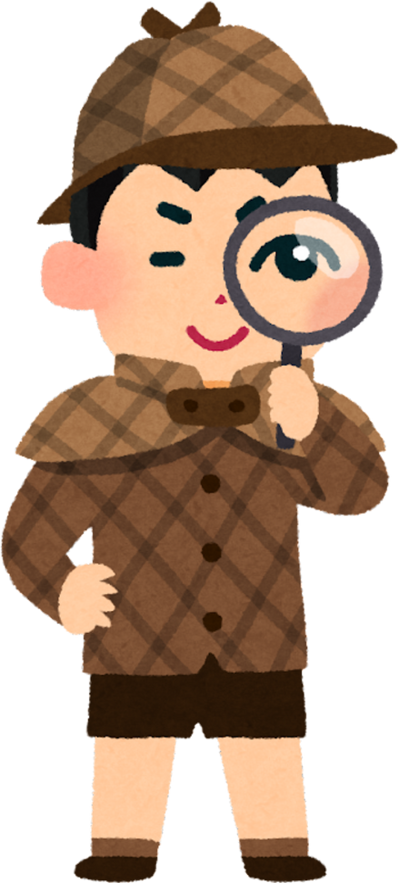
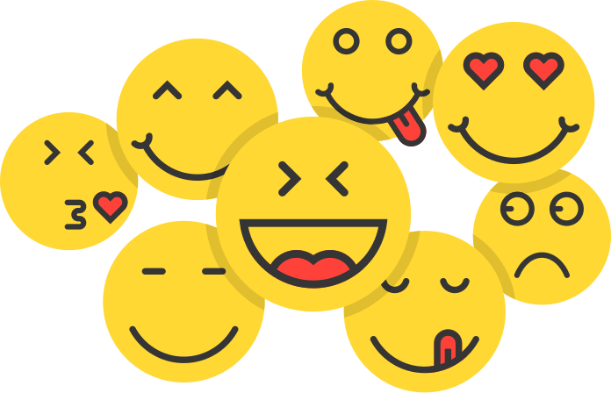
Wear a Rainbow day is all about helping Bridge the Gap to continue teaching children to become emotional detectives.

Slide 19
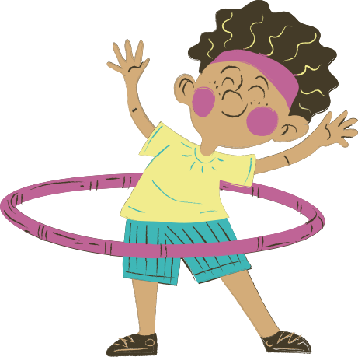
This is so they feel able to reach their goals in life and feel good about themselves.

Slide 20

Here are some of the rooms where we explore emotions

Slide 21
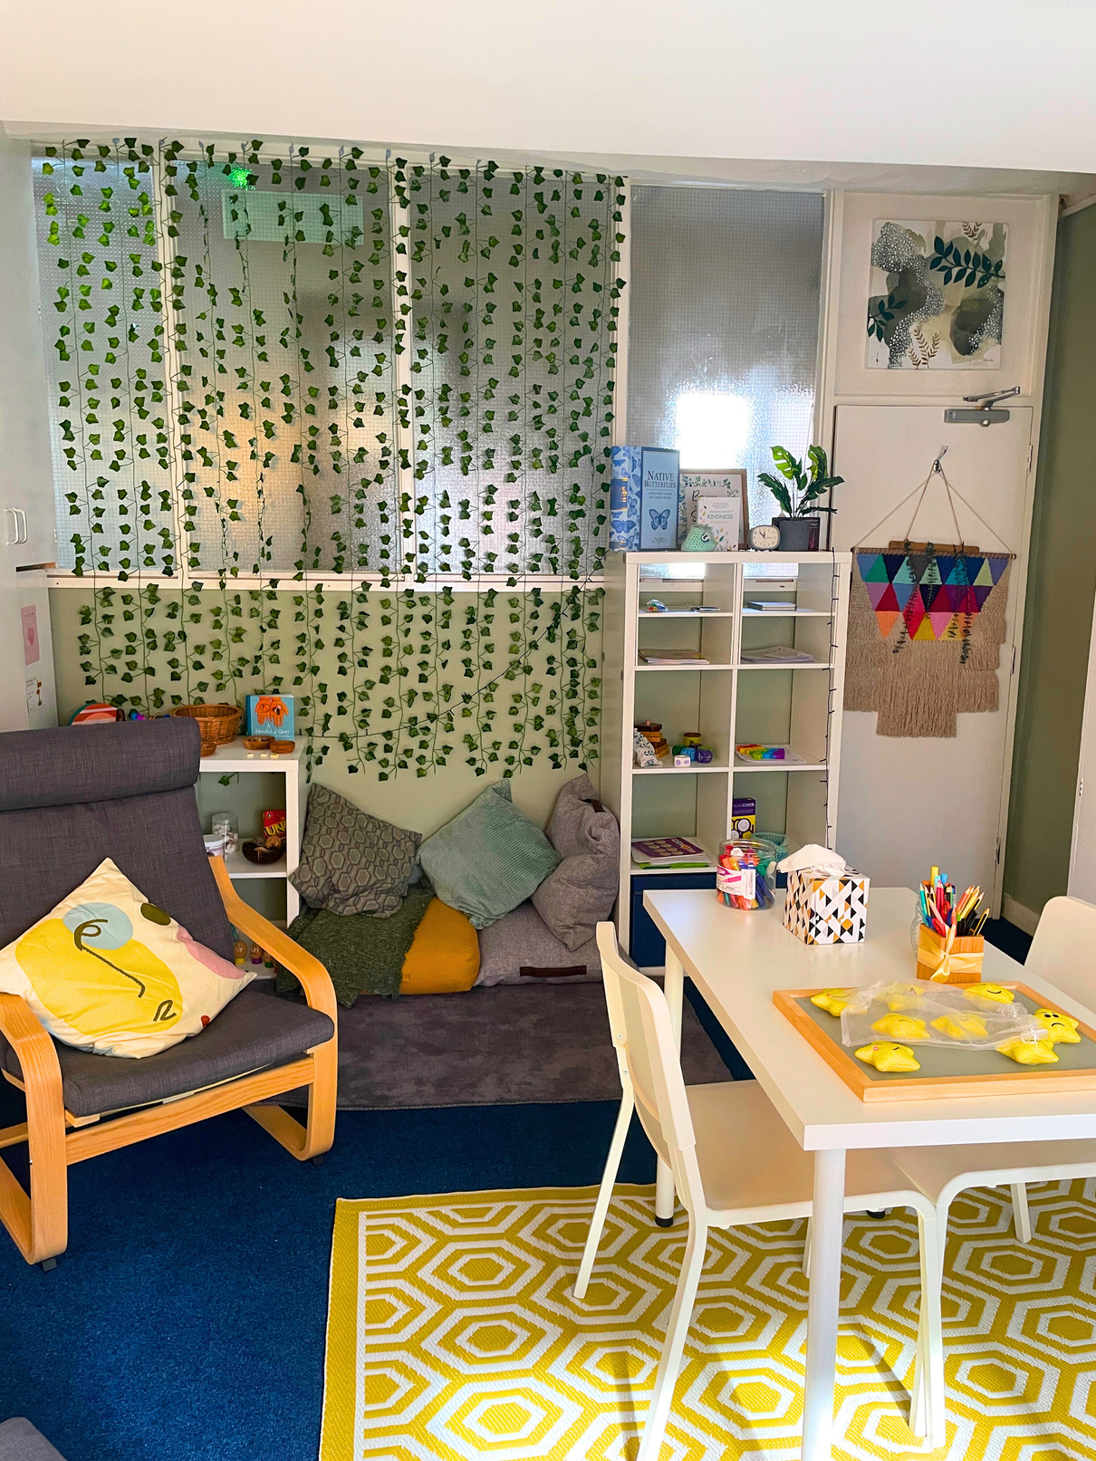
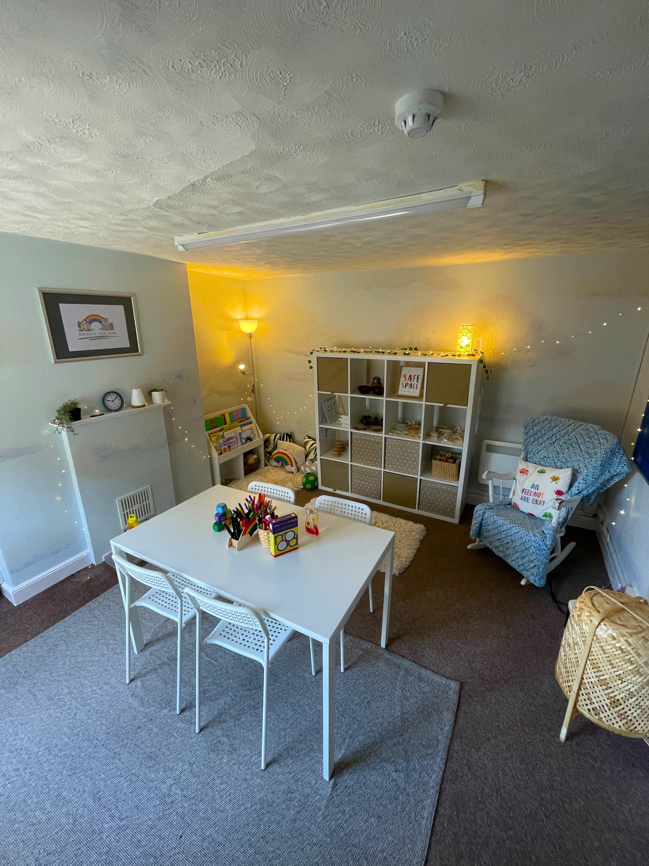
The Greenery
The Cloud Room

Slide 22
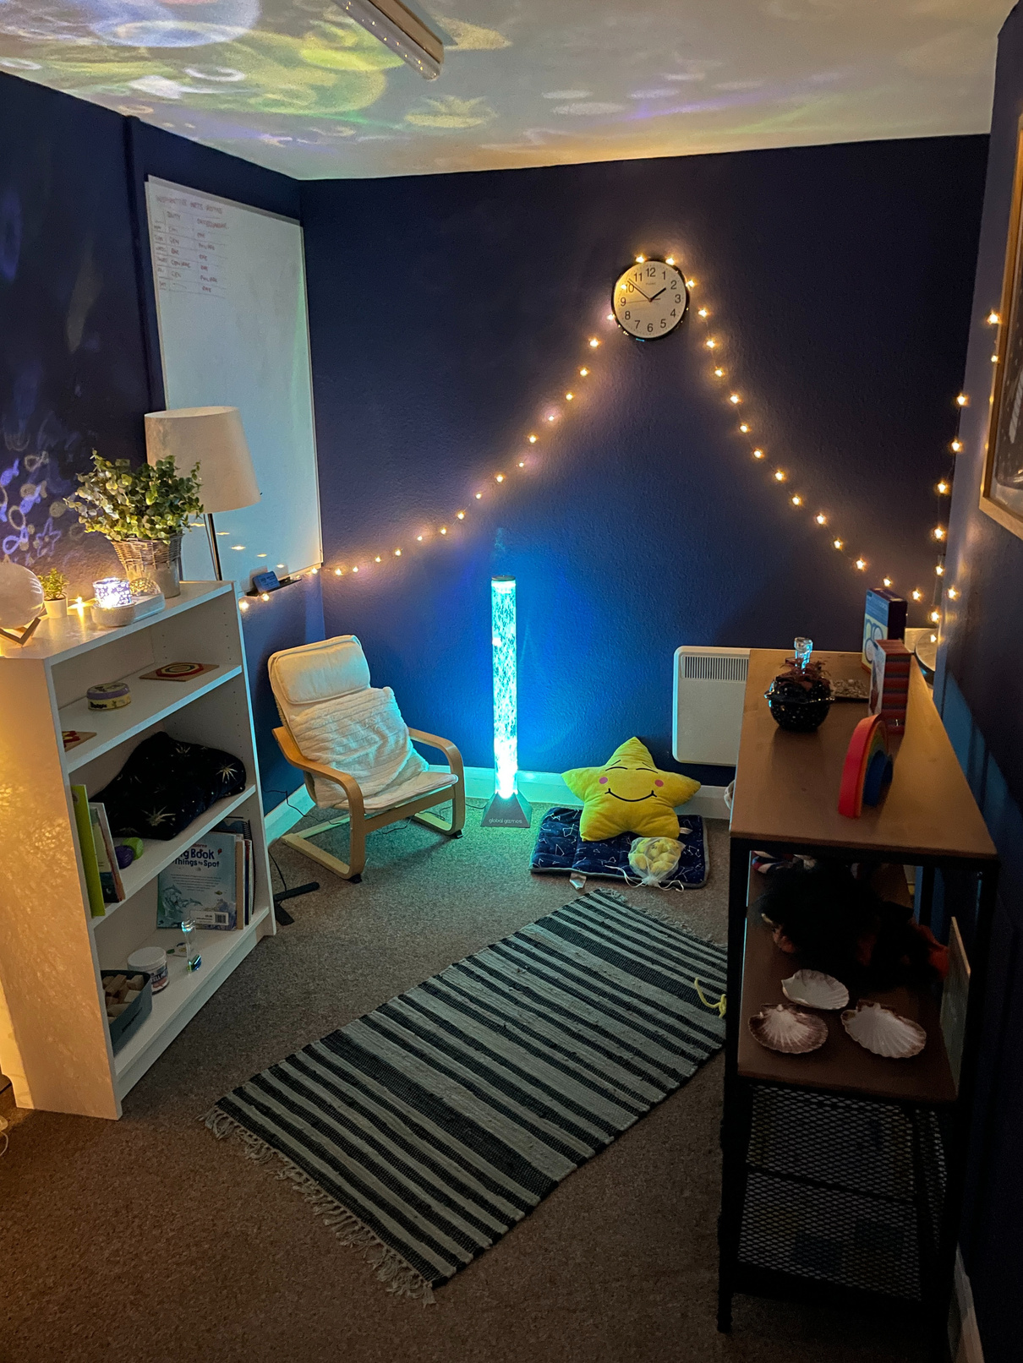
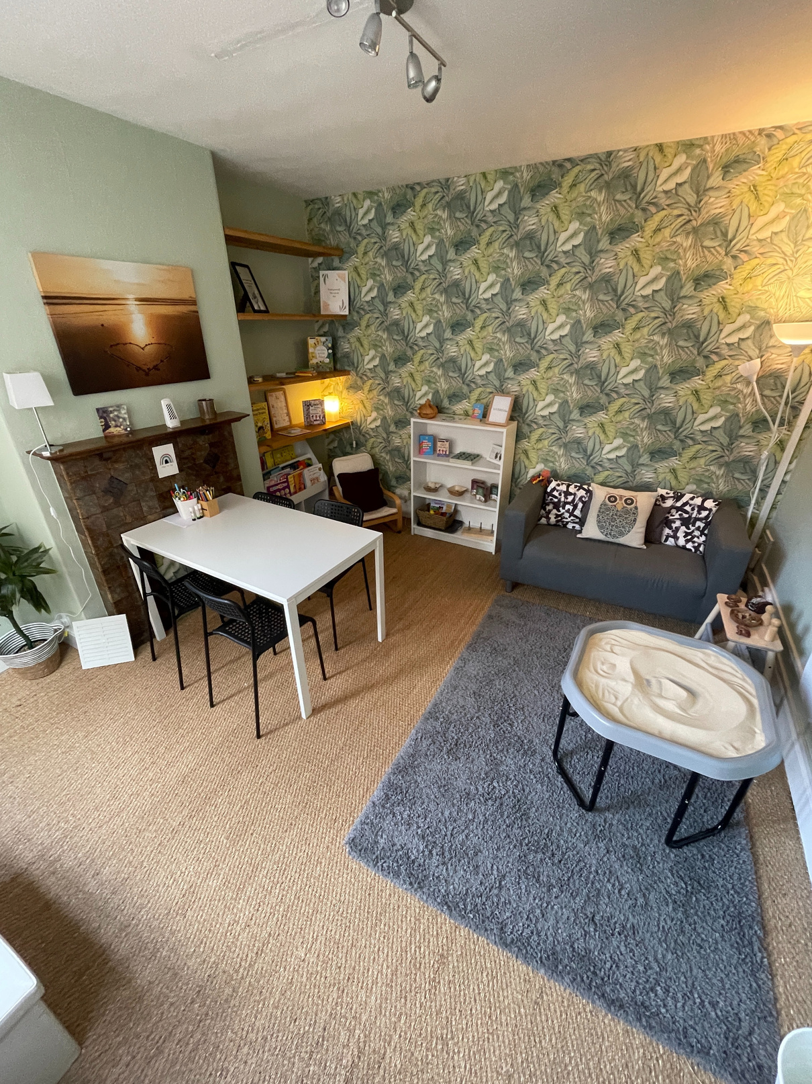
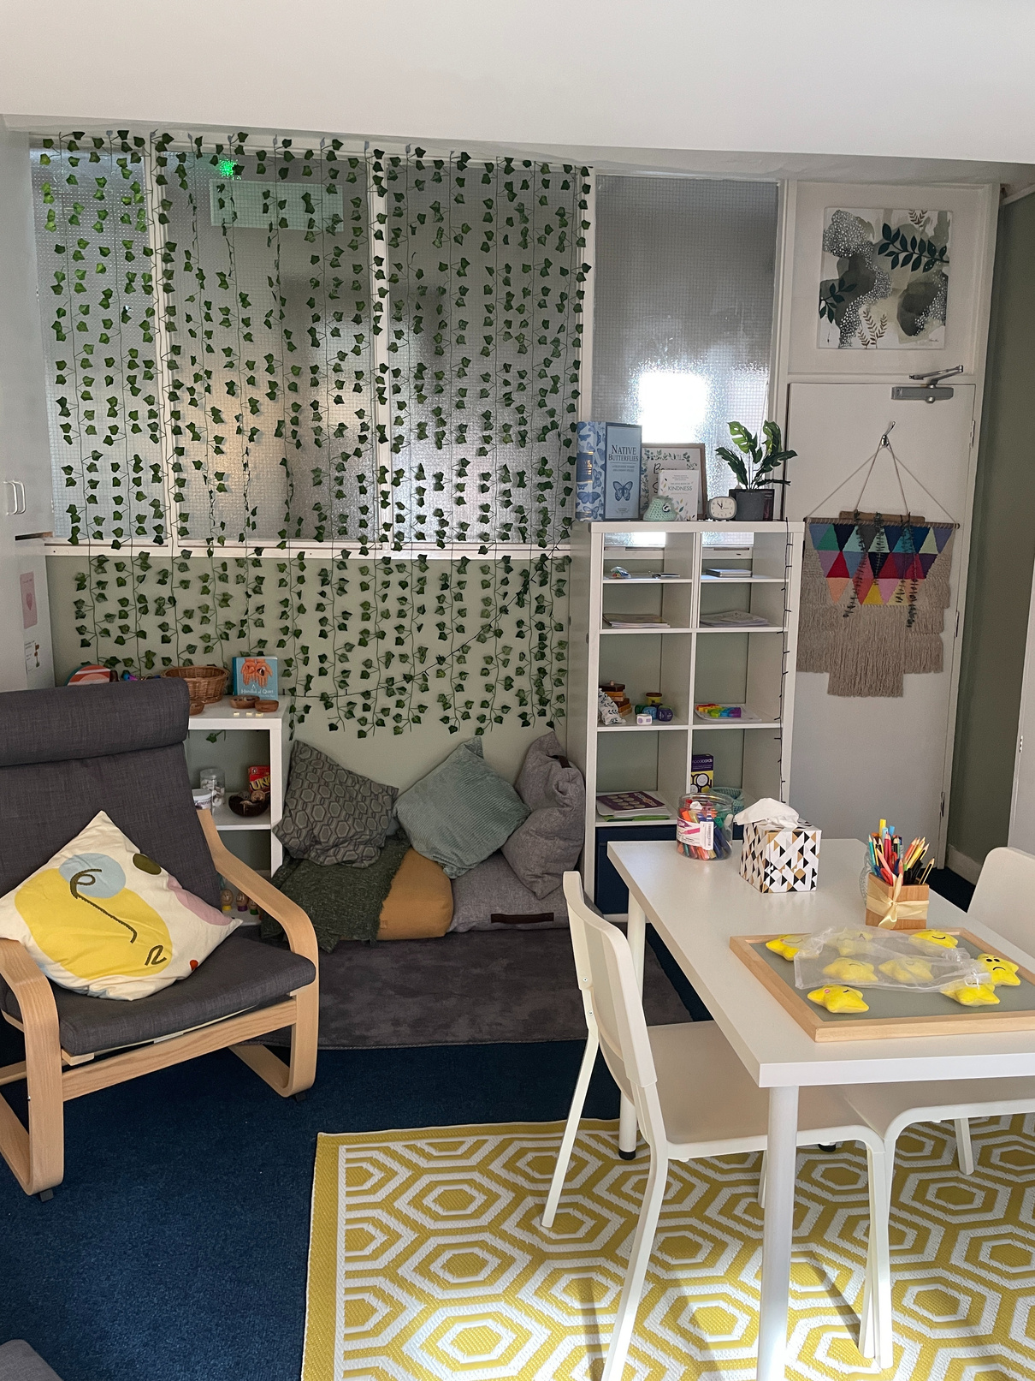

The Dream Room
The Sunlight Room

Slide 23
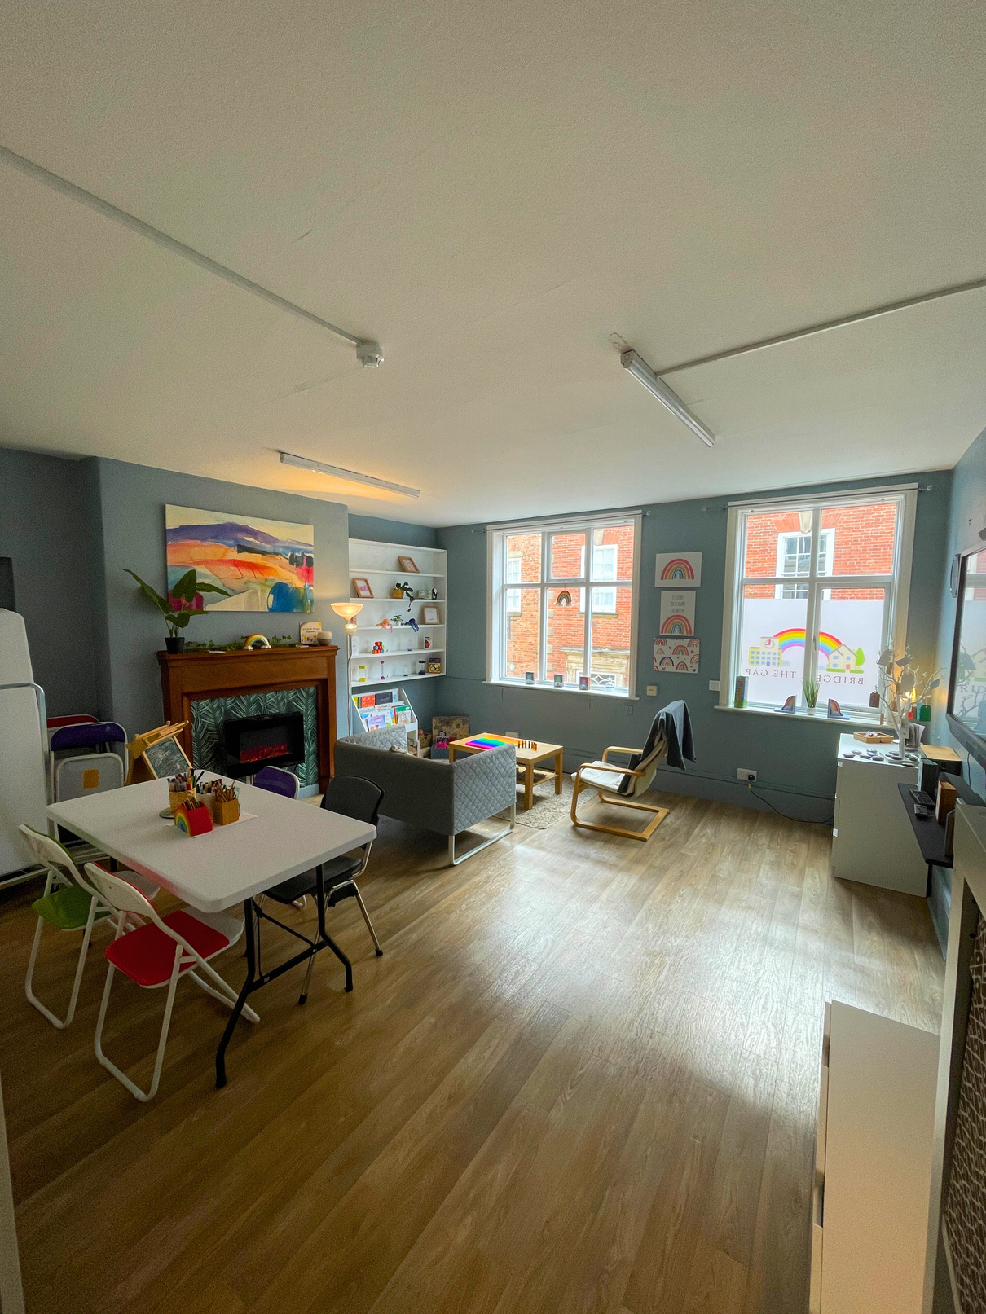
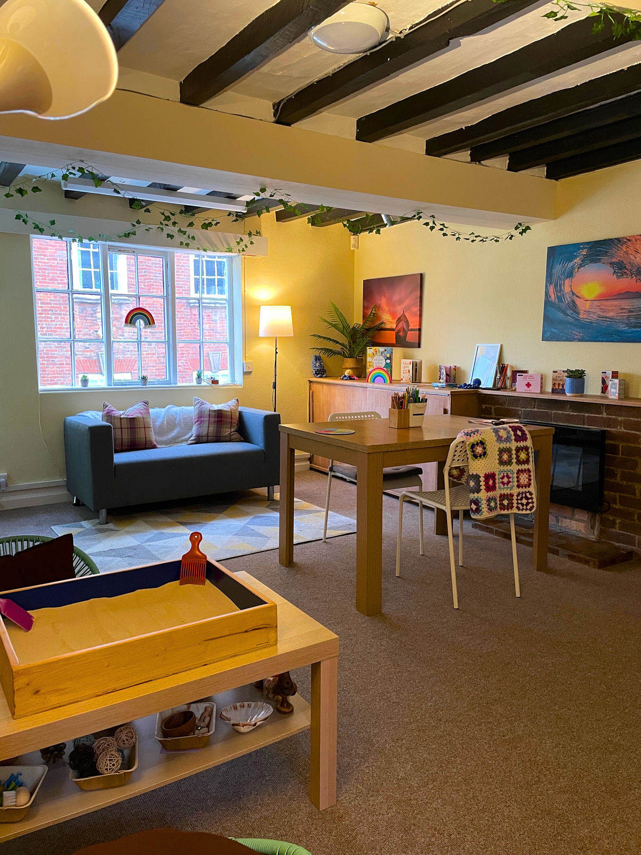
The Rainbow Room
The Nest

Slide 24

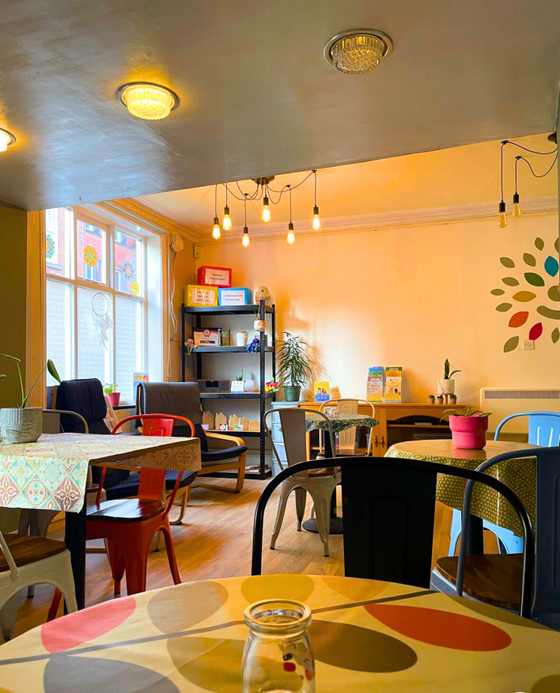
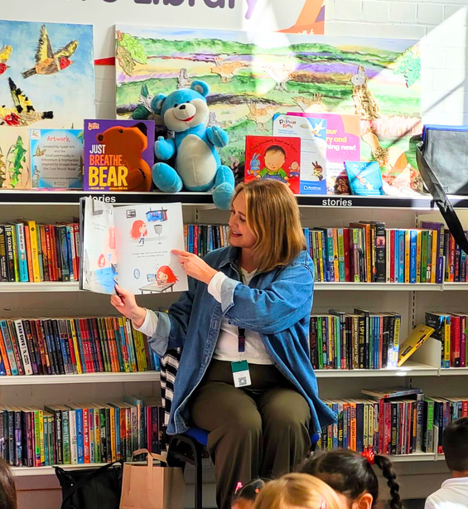
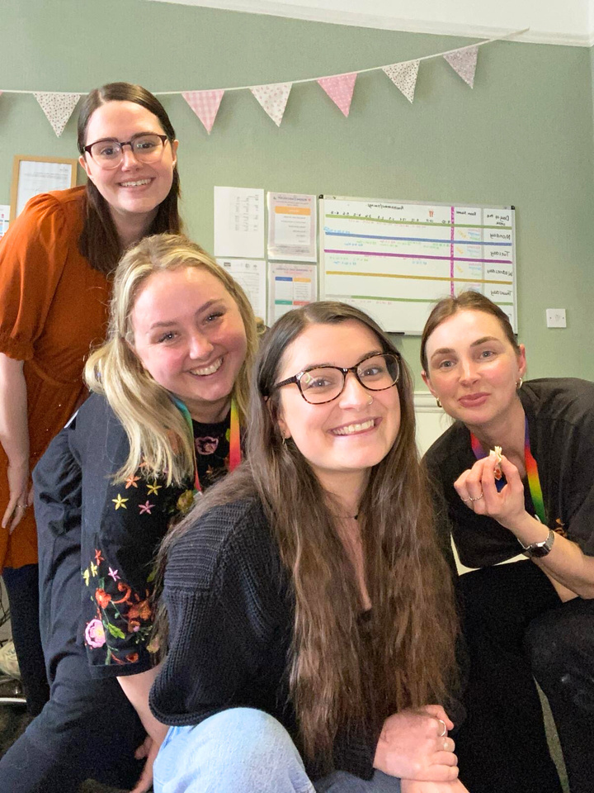
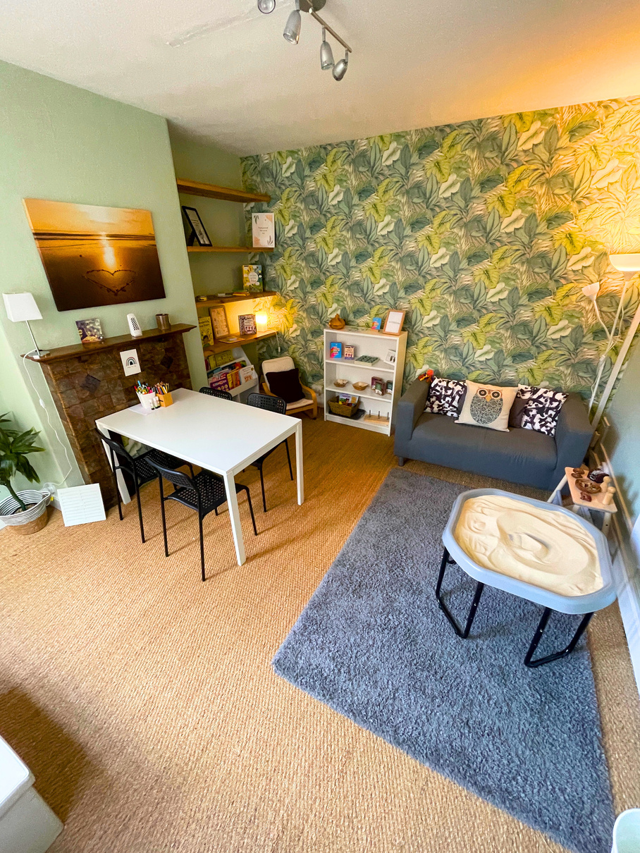



You can come and visit Bridge the Gap for fun groups, workshops, and our Derby Cares Café!
jwbridgethegap.com

Slide 25
You can come and visit Bridge the Gap for fun groups, workshops, and our Derby Cares Café!
jwbridgethegap.com

Slide 26

Wear your brightest rainbow colors to help raise money for early mental health support
Let’s brighten up our city with as many rainbows as we can!
#WearARainbow
jwbridgethegap.com

